Slide 1


Java ee
(ADVANCE JAVA)
Lecture-45

Slide 2
Today’s Agenda
Introduction To EL
Advantages Of El Over Java Beans
EL Attributes
EL Operators

Slide 3
EXPRESSION LANGUAGE
Expression Language(EL) was added to JSP 2.0 specification. And it’s main purpose is to produce scriptless JSP pages.
Although we can us scriptlets and JSP expressions to retrieve attributes and parameters in JSP with java code and use it for view purpose.
But for web designers, java code is hard to understand and that’s why Expression Language (EL) was introduced through which we can get attributes and parameters easily using HTML like tags.

Slide 4
ADVANTAGES OF EL
Although EL seems to do the same job as done by Java Beans but it has many advantages compared to Java Beans.
EL has more compact syntax than java beans or standard JSP tags.
EL lets us access nested properties.
EL lets us access beans as well as non bean objects like maps , arrays and lists

Slide 5
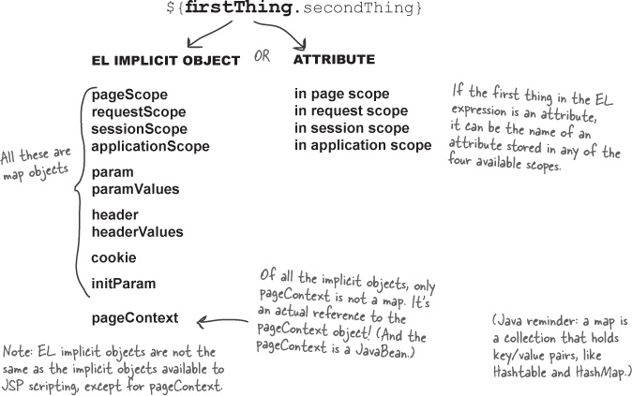
SYNTAX

Slide 6
EL IMPLICIT OBJECTS
Implicit Objects | Usage
pageScope | It is used to access the value of any variable which is set in the Page scope
requestScope | It is used to access the value of any variable which is set in the Request scope.
sessionScope | It is used to access the value of any variable which is set in the Session scope
applicationScope | It is used to access the value of any variable which is set in the Application scope
param | Map a request parameter name to a single value
paramValues | Map a request parameter name to corresponding array of string values.
header | Map containing header names and single string values.
headerValues | Map containing header names to corresponding array of string values.
cookie | Map containing cookie names and single string values.
initParam | Used to get the context init params
pageContext | Used to get the request, session references

Slide 7
USING EL TO ACCESS BEANS (HTML Page)
<html>
<head>
<title></title>
</head>
<body><center>
<h3>Input your data</h3>
<form action=“eldemo.jsp">
<table border="1">
<tr><th>Your Name:</th><td><input type="text" name="username"></td></tr>
<tr><th>Your Age:</th><td><input type="text" name="userage"></td></tr>
<tr><td ></td><td></td></tr>
<tr><td><input type="submit"></td></tr></table>
</form>
</center>
</body>
</html>

Slide 8
USING EL TO ACCESS BEANS (JSP Page)
<html>
<head>
<title>Using Expression Language</title>
</head>
<body><center>
<h2>Using EL with JavaBeans</h2>
<jsp:useBean id="p" class="mybeans.Person"/>
<jsp:setProperty name="p" property="name" param="username"/>
<jsp:setProperty name="p" property="age" param="userage"/>
<table border="1">
<tr><th>Name</th><td>${p.name}</td></tr>
<tr><th>Age</th><td>${p.age}</td></tr>
</table></center>
</body>
</html>

Slide 9
USING EL FOR ACCESSING HTML PARAMETERS
EL has got a special object called param which can be used for accessing html parameters i.e form data.
To access the form data we simply have to use the parameter name with param object .

Slide 10
USING EL FOR ACCESSING HTML PARAMETERS (HTML Page)
<html>
<head>
<title></title>
</head>
<body><center>
<h3>Input your data</h3>
<form action=“showperson.jsp">
<table border="1">
<tr><th>Your Name:</th><td><input type="text" name="username"></td></tr>
<tr><th>Your Age:</th><td><input type="text" name="userage"></td></tr>
<tr><td ></td><td></td></tr>
<tr><td><input type="submit"></td></tr></table>
</form>
</center>
</body>
</html>

Slide 11
USING EL FOR ACCESSING HTML PARAMETERS (JSP Page)
<html>
<head>
<title>Expression Language Demo</title>
</head>
<body><center>
<h2>Request Parameter Handling In EL</h2>
<h3>Name is :${param.username}</h3>
<h3>Age is :${param.userage}</h3>
</center>
</body>
</html>

Slide 12
USING EL FOR ACCESSING HTML PARAMETERS
We can also use the param object with java bean setProperty action element to read HTML values and put them inside bean.

Slide 13
EXAMPLE
<html>
<head>
<title>Using Expression Language</title>
</head>
<body><center>
<h2>Using Param Object with JavaBeans</h2>
<jsp:useBean id="p" class="mybeans.Person"/>
<jsp:setProperty name="p" property="name" value="${param.username}"/>
<jsp:setProperty name="p" property="age" value="${param.userage}"/>
<table border="1">
<tr><th>Name</th><td>${p.name}</td></tr>
<tr><th>Age</th><td>${p.age}</td></tr>
</table>
</body>
</html>

Slide 14
USING paramValues OBJECT
EL provides us another object called paramValues which can be used to retrieve those html fields which have same name.
For ex: if we are accepting two emails from the user and both the textboxes are named email then we can use paramValues for accessing both the email id.

Slide 15
USING paramValues OBJECT (The HTML Page)
<html>
<head>
<title></title>
</head>
<body><center>
<h3>Input your data</h3>
<form action="showperson.jsp">
<table border="1">
<tr><th>Enter Your Name:</th><td><input type="text" name="username"></td></tr>
<tr><th>Enter Your Age:</th><td><input type="text" name="userage"></td></tr>
<tr><th>Enter Your Email address:</th><td><input type="text" name="email"></td></tr>
<tr><th>Enter Your Alternate email:</th><td><input type="text" name="email"></td></tr>
<tr><td ></td><td></td></tr>
<tr><td><input type="submit"></td></tr>
</form>
</center>
</body>
</html>

Slide 16
USING paramValues OBJECT (The JSP Page)
<html>
<head>
<title>Expression Language Demo</title>
</head>
<body><center>
<h2>Request Parameter Handling In EL</h2>
<h3>Name is :${param.username}</h3>
<h3>Age is :${param.userage}</h3>
<h3>Main email is: ${paramValues.email[0]}</h3>
<h3>Alternate email is: ${paramValues.email[1]}</h3>
</center>
</body>
</html>

Slide 17
ACCESSING NON-BEAN DATA
EL allows us to access any data stored inside JSP objects using it’s scoped objects
To do this we just have to prefix the data value name with the any of the scoped objects of EL

Slide 18
ACCESSING NON-BEAN DATA
<%@page import="java.util.*" %>
<html>
<head>
<title>Expression Language Demo</title>
</head>
<body><center>
<h2>Attribute Demo In EL</h2>
<%
String str="welcome";
Date today=new Date();
request.setAttribute("str",str);
session.setAttribute("dt",today);
%>
Mesage is ${requestScope.str}<br>
Today's date is ${sessionScope.dt}
</center>
</body>
</html>
We also can remove the
name of scoped objects from
previous expression and write them as shown below:
Mesage is ${str}<br>
Today's date is ${dt}
EL will automatically search them
starting from pageScope to
applicationScope

Slide 19
NESTED PROPERTY WITH EL
EL is strong enough to pull bean from a bean i.e if we have a bean object dog with attributes name and breed and we have another bean called person which has dog as it’s attribute.
Then using EL we can access person’s dog’s name and it’s breed

Slide 20
NESTED PROPERTY WITH EL (The Dog Bean)
package mybeans;
public class Dog
{
private String name;
private String breed;
public void setName(String name)
{
this.name=name;
}
public String getName()
{
return name;
}
public void setBreed(String breed)
{
this.breed=breed;
}
public String getBreed()
{
return breed;
}
}

Slide 21
NESTED PROPERTY WITH EL (The Person Bean)
package mybeans;
public class Person
{
private String name;
private int age;
private Dog dog;
public String getName()
{
return name;
}
public int getAge()
{
return age;
}
public void setName(String name)
{
this.name=name;
}
public void setAge(int age)
{
this.age=age;
}
public void setDog(Dog dog)
{
this.dog=dog;
}
public Dog getDog()
{
return dog;
}
}

Slide 22
NESTED PROPERTY WITH EL (The HTML Page)
<head>
<title></title>
</head>
<body><center>
<h3>Input your data</h3>
<form action="setperson.jsp">
<table border="1">
<tr><th>Enter Your Name:</th><td><input type="text" name="name"></td></tr>
<tr><th>Enter Your Age:</th><td><input type="text" name="age"></td></tr>
<tr><th>Enter Your Dog's Name:</th><td><input type="text" name="name"></td></tr>
<tr><th>Enter Your Dog's Breed:</th><td><input type="text" name="breed"></td></tr>
<tr><td ></td><td></td></tr>
<tr><td><input type="submit"></td></tr>
</form>
</center>
</body>
</html>

Slide 23
NESTED PROPERTY WITH EL (The setperson.jsp Page)
<html>
head>
<title>Setting Beans Values</title>
</head>
<body>
<jsp:useBean id="p" class="mybeans.Person" scope="request" />
<jsp:useBean id="d" class="mybeans.Dog" />
<jsp:setProperty name="p" property="name" value="${paramValues.name[0]}" />
<jsp:setProperty name="p" property="age" value="${param.age}" />
<jsp:setProperty name="d" property="name" value="${paramValues.name[1]}" />
<jsp:setProperty name="d" property="breed" value="${param.breed}" />
<jsp:setProperty name="p" property="dog" value="${pageScope.d}" />
<%
RequestDispatcher disp=request.getRequestDispatcher("showperson.jsp");
disp.forward(request,response);
%>
</body>
</html>

Slide 24
NESTED PROPERTY WITH EL (The showperson.jsp Page)
<html>
<head>
<title>Expression Language Demo</title>
</head>
<body><center>
<h2>Accessing Nested Properties with EL</h2>
<table border="1">
<tr><th>Person's Name</th><td>${p.name}</td></tr>
<tr><th>Person's Age</th><td>${p.age}</td></tr>
<tr><th>Dog's Name</th><td>${p.dog.name}</td></tr>
<tr><th>Dog's Breed</th><td>${p.dog.breed}</td></tr>
</table>
</body>
</html>

Slide 25
THE EL [ ] Operator
EL provides us another operator called subscript operator represented as [ ]
It is more powerful than dot operator as we can use it to get the data from List and Array too.

Slide 26
THE EL [ ] Operator (Accessing array values)
<%@page import="java.util.*" %>
<html>
<head>
<title>Expression Language Demo</title>
</head>
<body><center>
<h2>Attribute Demo In EL</h2>
<%
String [ ]mycolors={"Red","Green","Blue"};
session.setAttribute("colors",mycolors);
%>
First Color is ${colors[0]}<br>
Second Color is ${colors[1]}<br>
Third Color is ${colors[2]}<br>
</center>
</body>
</html>

Slide 27
THE EL [ ] Operator (Accessing List values)
<h3>First food is ${foods[0]}</h3>
<h3>Second food is ${foods[1]}</h3>
<h3>Third food is ${foods[2]}</h3>
<h3>Fourth food is ${foods[3]}</h3>
<h3>Fifth food is ${foods[4]}</h3>
<h3>All foods are ${foods}</h3>
</center>
</body>
</html>
<%@page import="java.util.*" %>
<html>
<head>
<title>Expression Language Demo</title>
</head>
<body><center>
<h2>Attribute Demo In EL</h2>
<%
ArrayList foods=new ArrayList();
foods.add("indian");
foods.add("mughlai");
foods.add("chinese");
foods.add("italian");
foods.add("continental");
session.setAttribute("foods",foods);
%>

Slide 28
THE EL [ ] Operator (Accessing Bean values)
<html>
<head>
<title>Using Expression Language</title>
</head>
<body>
<center>
<h2>Using EL with JavaBeans</h2>
<jsp:useBean id="p" class="mybeans.Person"/>
<jsp:setProperty name="p" property="name" param="username"/>
<jsp:setProperty name="p" property="age" param="userage"/>
<table border="1">
<tr><th>Name</th><td>${p["name"]}</td></tr>
<tr><th>Age</th><td>${p["age"]}</td></tr>
</table>
</center>
</body>
</html>

Slide 29
EL ARITHMETIC OPERATORS
Arithmetic Operation | Operator
Addition | +
Substraction | -
Multiplication | *
Division | / and div
Remainder | % and mod

Slide 30
EL RELATIONAL &
LOGICAL OPERATORS
Logical and Relational Operator | Operator
Equals | == and eq
Not equals | != and ne
Less Than | < and lt
Greater Than | > and gt
Greater Than or Equal | >= and ge
Less Than or Equal | <= and le
and | && and and
or | || and or
not | ! and not

Slide 31
EXAMPLE
<table border="1">
<tr>
<th>EL Expression</th>
<th>Result</th>
</tr>
<tr>
<td>\${2}</td>
<td>${2}</td>
</tr>
<tr>
<td>\${2+2}</td>
<td>${2+2}</td>
</tr>
<tr>
<td>\${2 div 4}</td>
<td>${2 div 4}</td>
</tr>
<tr>
<td>\${2/0}</td>
<td>${2/0}</td>
</tr>
<tr>
<td>\${2 mod 4}</td>
<td>${2 mod 4}</td>
</tr>
<tr>
<td>\${2 % 4}</td>
<td>${2 % 4}</td>
</tr>
</table>

Slide 32
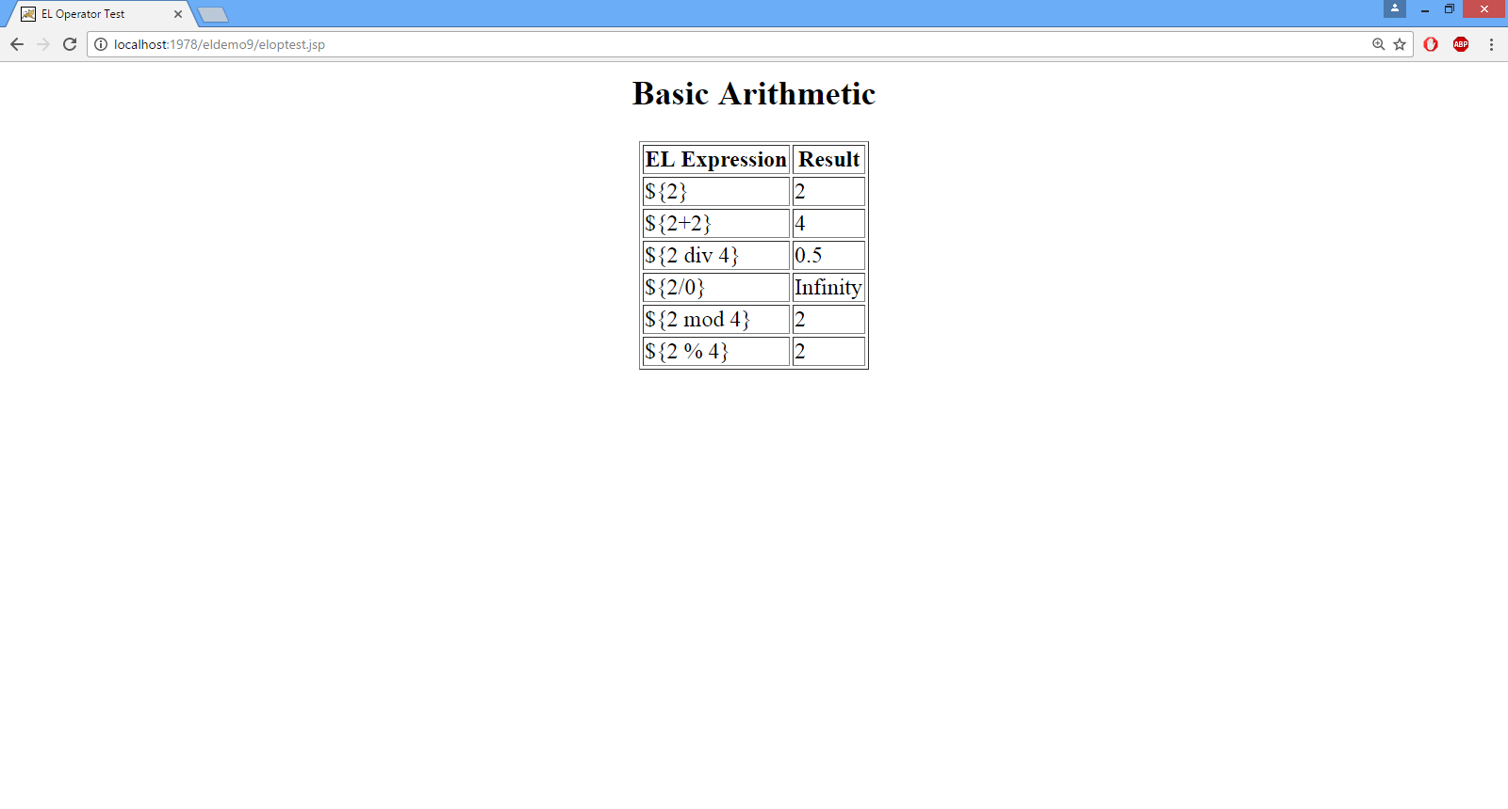
EXAMPLE

Slide 33

End Of Lecture
For any queries mail us @: scalive4u@gmail.com
Call us @ : 0755-4271659, 7879165533
Agenda for Next Lecture:
Introduction To Custom Tags
Advantages Of Custom Tags
Classes And Interfaces Used For Custom Tags
Examples

